Slide 2
WAGGGs Global Round Table
Brand in Action
Notes:
Natalie and steph introduce themselves and the core topic of the session. Hopefully they’ve learned a lot and hopefully we can take that learning and help you make some practical use of it in your own settings.

Slide 3
90 minutes before lunch
“prepare to learn, prepare to be lead” ☺
Group session - what’s been learned:
5 mins
Getting in the right frame of mind:
5 mins
How To: Build a brand:
5 mins
Team brand building workshop (40 mins)
45 mins
Review our brand keys
20 mins
Notes:
15 minutes
Steph gives a bit more detail - individual team focus on developing their own brand in action. Re-grouping to look at teamwork and explore commonalities and departures across the different teams and territories. First leading “from the floor” contribution as to what has been useful and interesting about the previous presentations on brand and role/what has been understood as the core purpose and benefits of brandpower/what people still might feel unconfident about.
Natalie – Yes, Let’s5 MINUTES

Slide 4
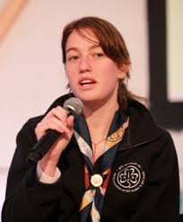
Speak Out
(What’s been useful so far? What’s brand power all about?)
Notes:
Steph leads: “from the floor” contribution as to what has been useful and interesting about the previous presentations on brand and role/what has been understood as the core purpose and benefits of brandpower/what people still might feel unconfident about.
Natalie warms up – Yes, Let’s5 MINUTES

Slide 5
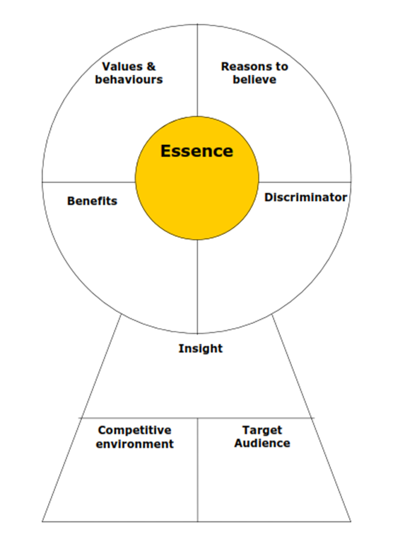
Theory into practice
Notes:
Steph to talk about brand key as a tool to articulate a brand - and its pivotal role in keeping organisations on track, consistent, joined up and focussed. Explain that there are different templates but the principles are the same whether you are developing a brand strategy for Unilever or for Unicef. As a rule, the process to deliver a compelling and sustainable brand key will involve a level of stakeholder consultation, target audience research, market analysis, culture auditing and so on. The section called insight will be an observation about your target audience or the environment in which you operate that is evidence based and which clearly identifies that there is a role for you and a place for what you offer.
And, as a rule this process can take anything from 8 weeks to 12 months depending upon the complexity of the organisation. But your challenge today is going to be to make a start in the next 45 minutes, populating all but the insight and Essence fields. We’re then going to ask you to pin up your workings and talk about where there is commonality across territories and where they diverge.
5 minutes

Slide 6
territory 1: Your Westminster
Inherent sense of ownership by citizens
past and present
workings driven by public and the democracy
Democratic
Open
Personal
Your Westminster
Sharing ownership
/responsibility
Enabling
Empowering
Belonging to the people
Throughout history and to the present day it’s the place where people believe their personal story has its roots
Target clusters as defined
International (commonwealth and old
empires)
Employees
Notes:
Steph: reference Westminster and how the brand key evolves usually through a number of stages.

Slide 7
Let’s make a start.
(on our own brand keys).
Notes:
Steph. We’re going to take each segment and think about it as we go along. You will need to debate and discuss your views with your table and once agreed, jot down your table’s answers in the box on the key on your table.

Slide 8
Values & Behaviours
Start with the easy one. What, are our organisation’s shared values and behaviours. Usually there are 3. Social & Local’s are: Sharing ; Influencing ; Joy
Notes:
Nats to coach through. This one could ask each table to discuss and then write down 3 values and behaviours – encourage the table to discuss challenges in driving the behaviours and what to remember they must be sustainable./fill in your key
6-7 minutes

Slide 9
Target Audience
2. Who do we want our brand to talk to? Be specific and try and give us a feel for who they are. One of Social & Local’s audiences is Leaders of the top 20 Charities in the UK but another
Is regulators in the advertising industry
Notes:
Steph to coach through
I’d like each table to think about the groups of people that their brand needs to talk to. Don’t be superfluous – think about your resources and what groups are truly essential to your organisational goals.
6-7 minutes

Slide 10
Competitors
3. Who’s competing For our target audience’s Attention? Social & Local’s will be marketing and brand communications Agencies in the UK.
Notes:
Nats 6-7 mins
Whether fundraising, volunteering, participating, supporting ….the people you want to talk to will also be targeted by others – they will be making choices, so who or indeed what (do you know about) competing for the attention of your target audience?

Slide 11
USP
4. What do we do that no other organisation does. What makes us unique to our target audience: Social & Local’s uniqueness is it’s blend of: social purpose with leading capability.
Notes:
Steph to coach through - OK, let’s get ruthless on this one. …6-7 mins

Slide 12
Audience benefit
5. What are the benefits
of our organisation to its
Audiences? Social & Local’s are: Highest quality; Priced competitively; with Social contribution built in
Notes:
Nats to coach through6-7 mins

Slide 13
Prove the benefit
6. So, what proves 2, 3 & 4?
What is the evidence that makes these claims true and indisputable (this is often a case study or tangible achievements or evidenced characteristics that can be demonstrated)
Notes:
Steph: tell us a story of a tangible achievement in their territory …..
6-7mins

Slide 14
Sharing time
6. So, what proves 2, 3 & 4?
What is the evidence that makes these claims true and indisputable (this is often a case study or tangible achievements or evidenced characteristics that can be demonstrated)
Start with the easy one. What, are our organisation’s shared values and behaviours. Usually there are 3. Social & Local’s are: Sharing ; Influencing ; Joy
4. What do we do that no other organisation does. What makes us unique to our target audience: Social & Local’s uniqueness is it’s blend of: social purpose with leading capability.
5. What are the benefits
of our organisation to its
Audiences? Social & Local’s are: Highest quality; Priced competitively; with Social contribution built in
3. Who’s competing For our target audience’s Attention? Social & Local’s will be marketing and brand communications Agencies in the UK.
2. Who do we want our brand to talk to? Be specific and try and give us a feel for who they are. One of Social & Local’s audiences is Leaders of the top 20 Charities in the UK but another
Is regulators in the advertising industry
Notes:
Steph – Nats to orchestrate
Bring this up to remind everyone of what they have been doing.
Explain that we have not worked on the essence, this may be something they want to think about as they head home.
Suggest that we ask each table to take one (or two of the headings and share what they have come up with.
15 – 20 mins and close

