Slide 1
Please remove the slides for activities that you will not need and have a look at the notes section below for additional tips and instructions.

Slide 2
INTRODUCTION
Leader’s information slides | 3 – 6
World Thinking Day Fund | 7 – 8
Learning outcomes | 9 - 11
How to earn your badge | 12
STAND STRONG ACTIVITIES
Peace Puzzle | 14 - 17
Decoder | 18 – 20
Your Unique Potential | 21 - 28
STAND UP ACTIVITIES
Who Caused The Conflict | 30 - 33
Women Peacebuilders | 34 - 39
STAND TOGETHER ACTIVITIES
Thinking About Peace | 41 -45
Memory Coin | 46 - 48
Pass The Peace | 49 - 51
Things I Can Change | 52 - 55
Ripples Of Peace | 56 - 57
CLOSING ACTIVITY
Our global promise activity | 58 - 62

Slide 3
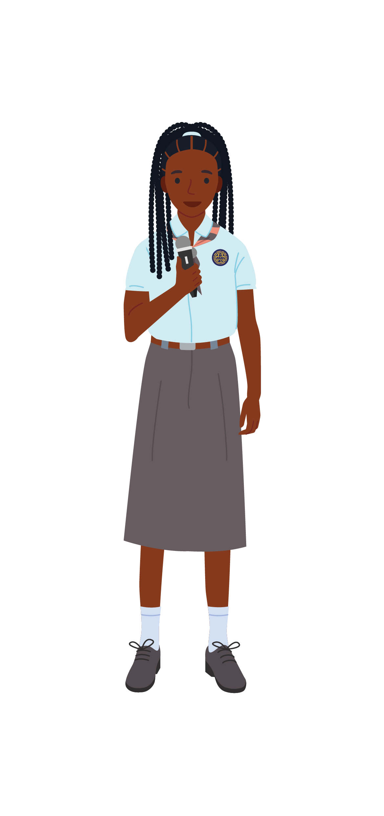
Thank you for downloading the online presentation for ‘Stand Together For Peace’.
You can use these slides adapted from the World Thinking Day 2021 activity pack to stand together with 10 million Girl Guides and Girl Scouts to call for and create peace in our lives and in the world.
The activities in these slides have been designed to create opportunities to practice your leadership in line with the new Girl Guide and Girl Scout Leadership Model
Choose the three activities you want to complete and delete the other slides as appropriate. Remember to look out for the ‘leader information’ slides and the notes section below for leader instructions.
Notes:
(Optional)
This page is intended for leader’s information only

Slide 4
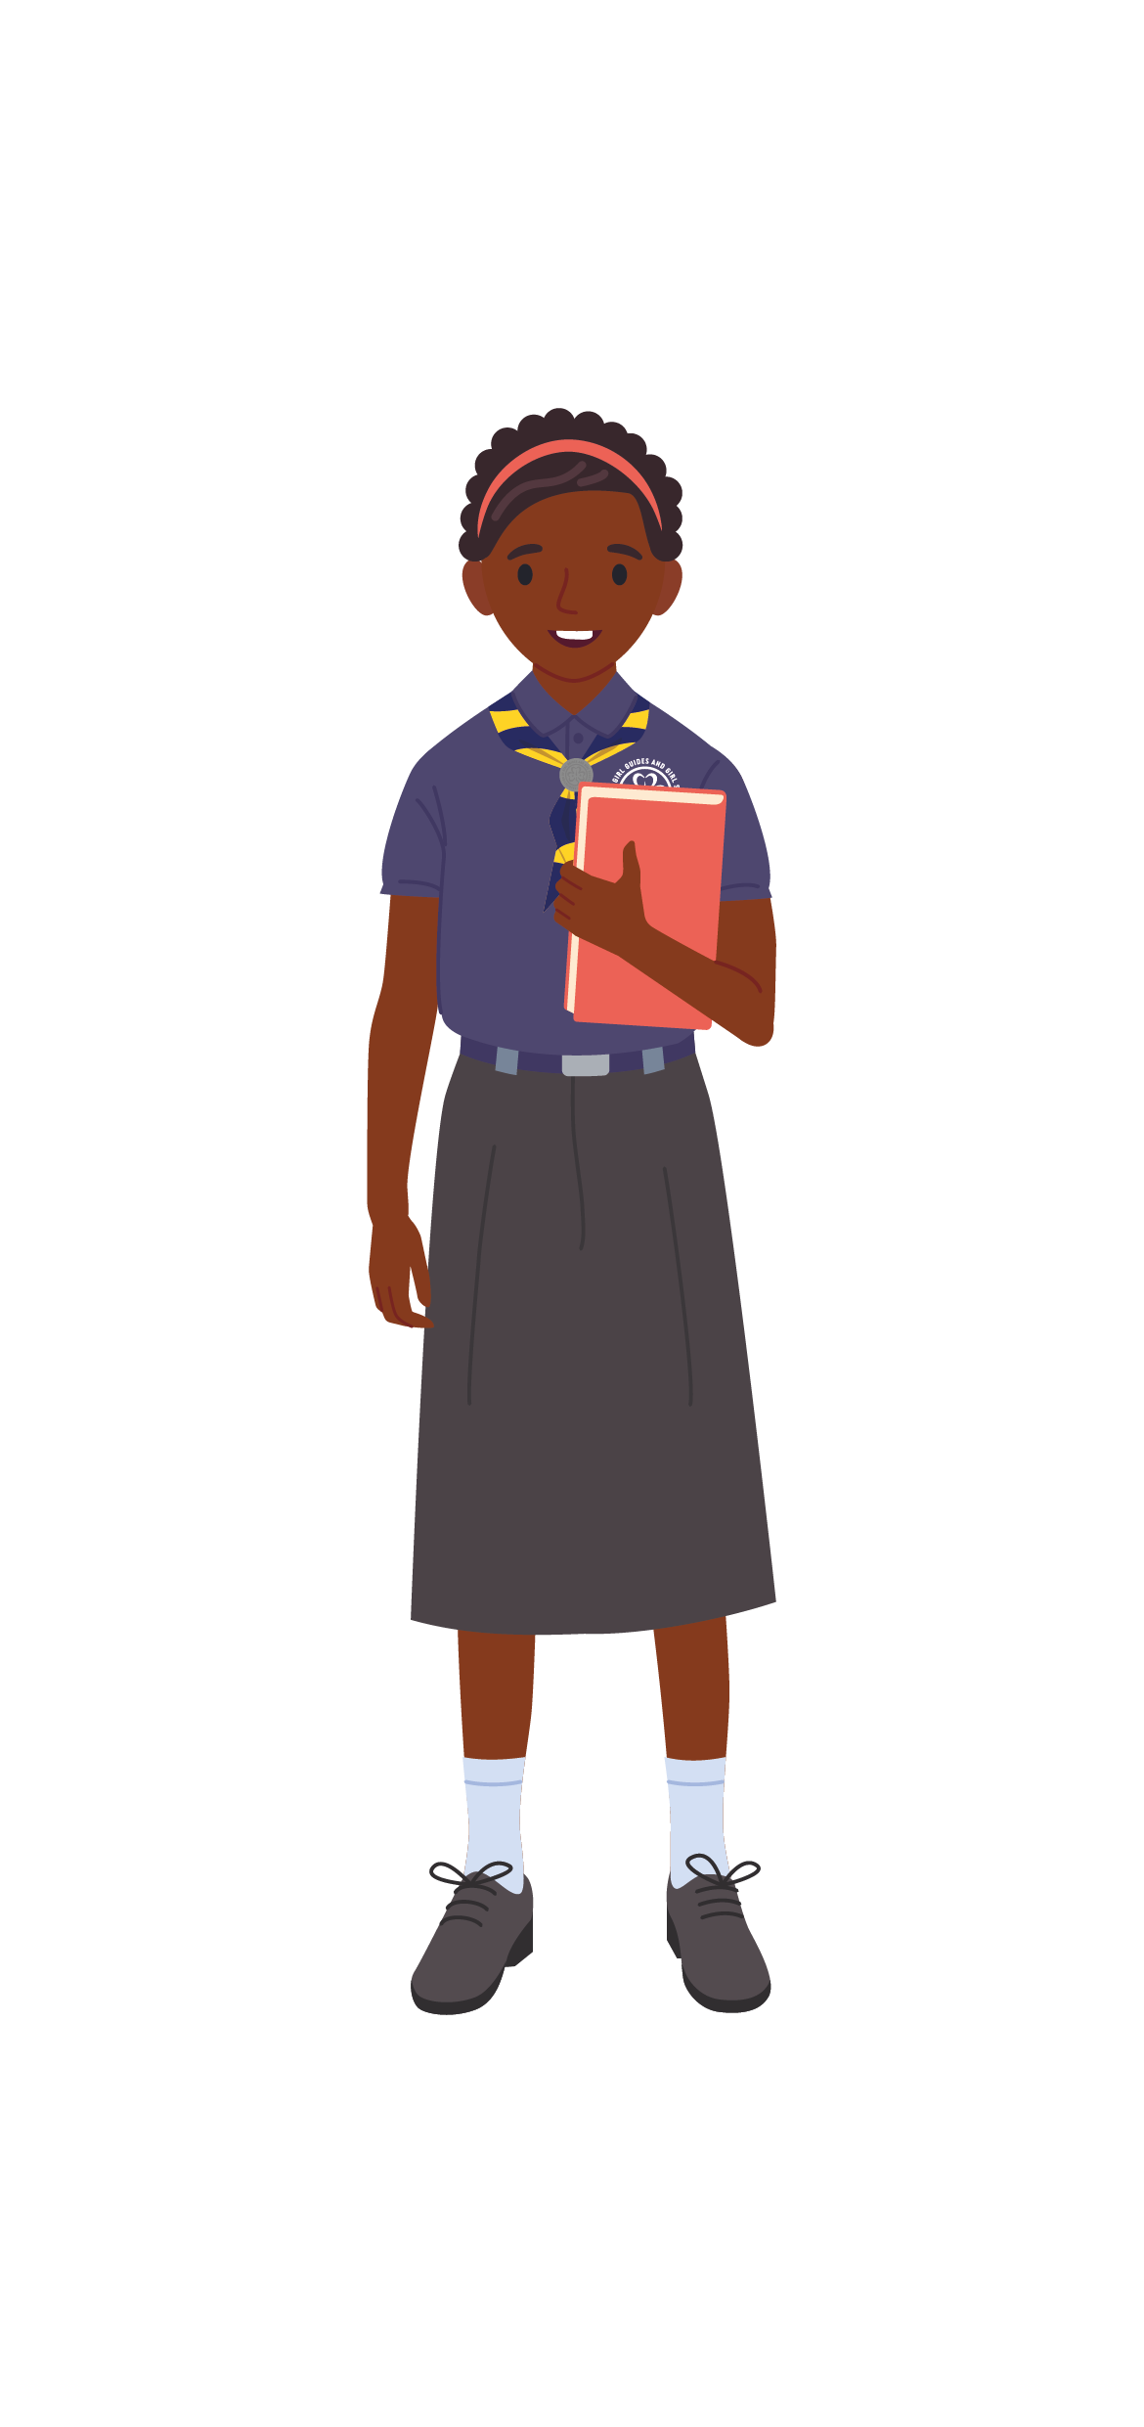
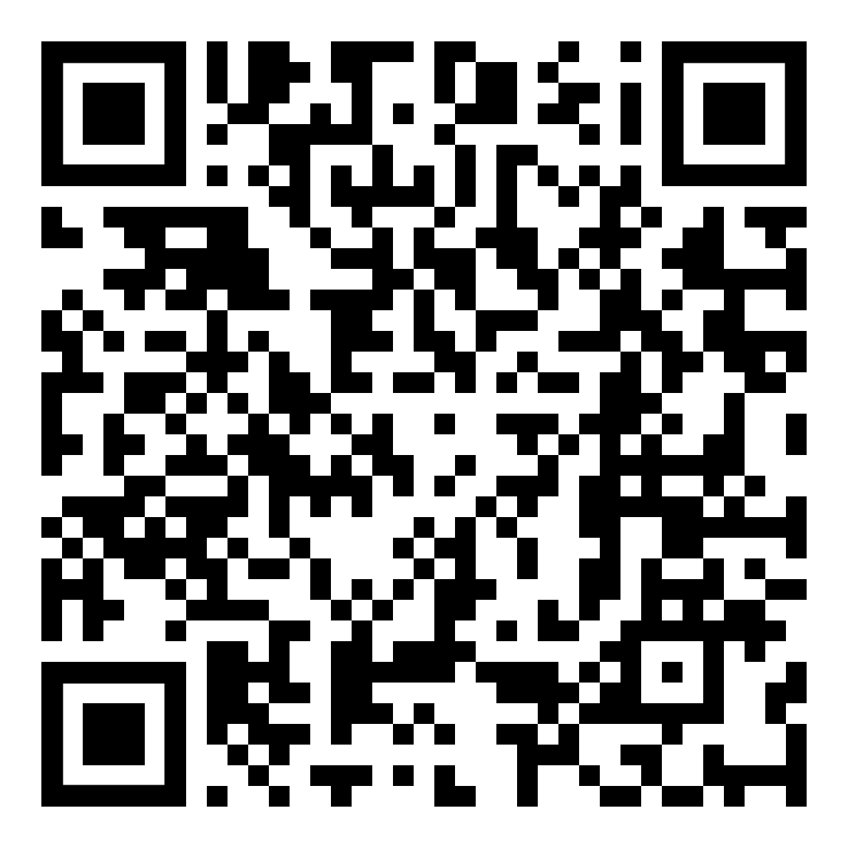
We have compiled some of the activities from the full pack into this presentation. The following activities have been adapted to be delivered online.
Remember, to further adapt the activities to suit your group’s needs.
For more activities, please see the full activity pack.
Scan this QR code to see the full activity pack.
https://www.wagggs.org/en/resources/world-thinking-day-2021-activity-pack/
Notes:
(Optional)
This page is intended for leader’s information only
You can choose to read this to your group at the start of the activity rather than showing the slide – this will depend of the reading levels of the girls in your group.

Slide 5
Involve the whole group in deciding which activities to work on and how to complete them.
Encourage and support each other to take the lead in planning and facilitate/narrate an activity where possible.
Use the activities to create spaces for reflection and conversation about peacebuilding.
Notes:
(Optional)
This page is intended for leader’s information only
You can choose to read this to your group at the start of the activity rather than showing the slide – this will depend of the reading levels of the girls in your group.

Slide 6
TOP TIPS
Vocally state that your space is safe for all who wish to participate.
As a group come up with clear guidelines to promote respect and openness for everyone and agree how the group will keep to the guidelines.
Stress the importance of confidentiality.
Be aware of what is happening in your community and the world that may be impacting your group members.
Be mindful of your facilitation approach to make sure all voices have space to be heard.
Be ready to adapt your programme. If the group are deep in a powerful conversation, it is fine to change the plans, so they have more time to work through that conversation.
Avoid making generalisation when speaking about different issues.
Plan how you will support group members to speak up or seek support if they don’t feel safe and communicate this to the group.
Notes:
Remember:
When facilitating Stand Together for Peace, it is important to create a safe space where participants feel they can be
brave, get out of their comfort zones, truly hear each other’s stories, and trust others to hear them. You can use many
different methods for this. Some things you might want to consider:

Slide 7
Since 1932, millions of Girl Guides and Girl Scouts around the world have celebrated World Thinking Day by fundraising.
It is a way of appreciating the opportunities given by Girl Guiding and Girl Scouting and then giving more girls around the world the chance to be Girl Guides and Girl Scouts.
In 1932 Lady Olave Baden-Powell said:
“There are a million of us. I am not good at arithmetic and I will not make any calculations which may not come true. But a penny, or two cents, or four annas or enough centimes or groschen or Heller or Filler or ore to make the same value, is not an immense amount, especially when it is perhaps saved or earned and given with a willing hand.”

Slide 8
Collect
Contribute to the fund and complete this year’s World Thinking Day Fund activity ‘the memory coin’.
Send
I’ve collected, what next? You have two options to send your donations to WAGGGS:
Your National Association – Contact them first. Many National Associations collect donations to send to WAGGGS.
Directly to WAGGGS – You can donate online or by Cheque, Credit Card or Bank Transfer or Fundraise Online: bit.ly/WTDFund
This past year has been particularly challenging for Girl Guide and Girl Scout groups all over the world.
The World Thinking Day Fund helped to keep Girl Guiding and Girl Scouting online when many of us could not meet in person.
Once we receive your donations, you will receive a special World Thinking Day ‘Thank You’ card and certificate as our way of showing our appreciation for all your hard work.

Slide 9
These online activities will help us to:
STAND STRONG
Understand how we all can build peace.
STAND UP
Think about the things we do that are very peaceful, and the things that are not so peaceful.
STAND TOGETHER
Take action towards to make a more welcoming and peaceful for people around us.
Notes:
(Optional)
This page is intended for leader’s information only
You can choose to read this to your group at the start of the activity rather than showing the slide – this will depend of the reading levels of the girls in your group.

Slide 10
These online activities will help us to:
STAND STRONG
Understand what peacebuilding means.
Explore actions that you can take to can lead to build peace or create conflict.
STAND UP
Practice looking at a situation from someone else’s perspective.
Understand how our behaviours and attitudes can create or disrupt peace
STAND TOGETHER
Make choices rooted in your values.
Take action towards creating a more welcoming and peaceful society.
Notes:
(Optional)
This page is intended for leader’s information only
You can choose to read this to your group at the start of the activity rather than showing the slide – this will depend of the reading levels of the girls in your group.

Slide 11
These online activities will help us to:
STAND STRONG
Understand what peacebuilding means.
Explore actions that can lead to conflict or peace.
See how we can be peacebuilders.
STAND UP
Explore conflict situations from different perspectives.
Adapting our behaviour to resolve conflict and build peace.
Understand link between discrimination, exclusion, and peace.
STAND TOGETHER
Make choices rooted in your values.
Consider the ripple effect of your actions, and how this may impact different groups.
Take action towards creating a more welcoming and peaceful society.
Notes:
(Optional)
This page is intended for leader’s information only
You can choose to read this to your group at the start of the activity rather than showing the slide – this will depend of the reading levels of the girls in your group.

Slide 12
STEP 1
STEP 2
STEP 3
Create a brave space.
So that everyone can share and have fun together.
Complete at least one activity from each section:
STAND STRONG – STAND UP – STAND TOGETHER
Complete the ‘Our Global Promise’ activity
And renew your Girl Guide and Girl Scout Promise Together

Slide 14
Start in small groups if meeting in person. You can express your ideas with pictures and/or words
Be careful if using scissors, and be sure to protect clothes and tables if using paints
Each person will need a blank piece of paper that is roughly the same size.
Colored pens, markers, crayons, etc.
You may want to listen to some inspiring music while you create your puzzle!
Notes:
(Optional)
This page is intended for leader’s information only

Slide 15
ACTIVITY
In small groups, discuss what peace means to you.
What feelings, ideas, places come to mind when you think about peace?
Peace is not just the absence of war, it means dignity, safety, and well-being for all.
How peace is defined is different for everyone and it can range from being happy in ourselves and seeing the smiling faces of our loved ones, to conflict resolution within a community and ending violence and harmful practices around the world.

Slide 16
ACTIVITY
Now it’s time to create your Peace Puzzle
Fill up your blank piece of paper with words, phrases, and drawings that shows your personal definition of peace (the answer you can up with for the first part of the activity).
Hold your puzzle pieces up to the screen so that it covers your whole camera. Have a look at the amazing digital mural you have made. This is your group’s visual definition of peace!

Slide 17
LET’S REFLECT
Choose one of the following questions and discuss.
How different were the ideas within your group?
Where there many common ideas you could see?
Did you understand the ideas and definitions of peace that were different to yours?
Which definition means more to you, the definition from the previous slide, or your personal definition? Why?
How can you bring this mural to life through your behaviours and activities in Girl Guides / Girl Scouts?
Notes:
Activity steps:
Choose one question from the first box to answer and answer the question at the bottom of the page:
“How can you bring this mural to life through your behaviours and activities in Girl Guides/ Girl Scouts?” write down these ideas and revisit them when planning your group’s programme later in the year.

Slide 18
This activity was adapted from the PeaceJam Foundation Compassion in Action curriculum
Choose your ‘media example’ before starting the activity
Selection of media examples, such as
Newspapers
Magazines
Films trailers
Songs
Advertisement
Posters
Notes:
(Optional)
This page is intended for leader’s information only

Slide 19
ACTIVITY
Spend five minutes reading, listening to or looking at your media source and answer these questions:
1. What is its main message?
How does it promote the inclusion of specific groups of people or the exclusion of others and their ideas? (Does this bring people together or push people further apart?)
Do you think this represents most of the media you listen to, read or see? Why?
2. How do you think these messages help build stereotypes of prejudice, or help to break them?
3. What is one way you can decode media in the future so that it has less on an impact on your daily life?

Slide 20
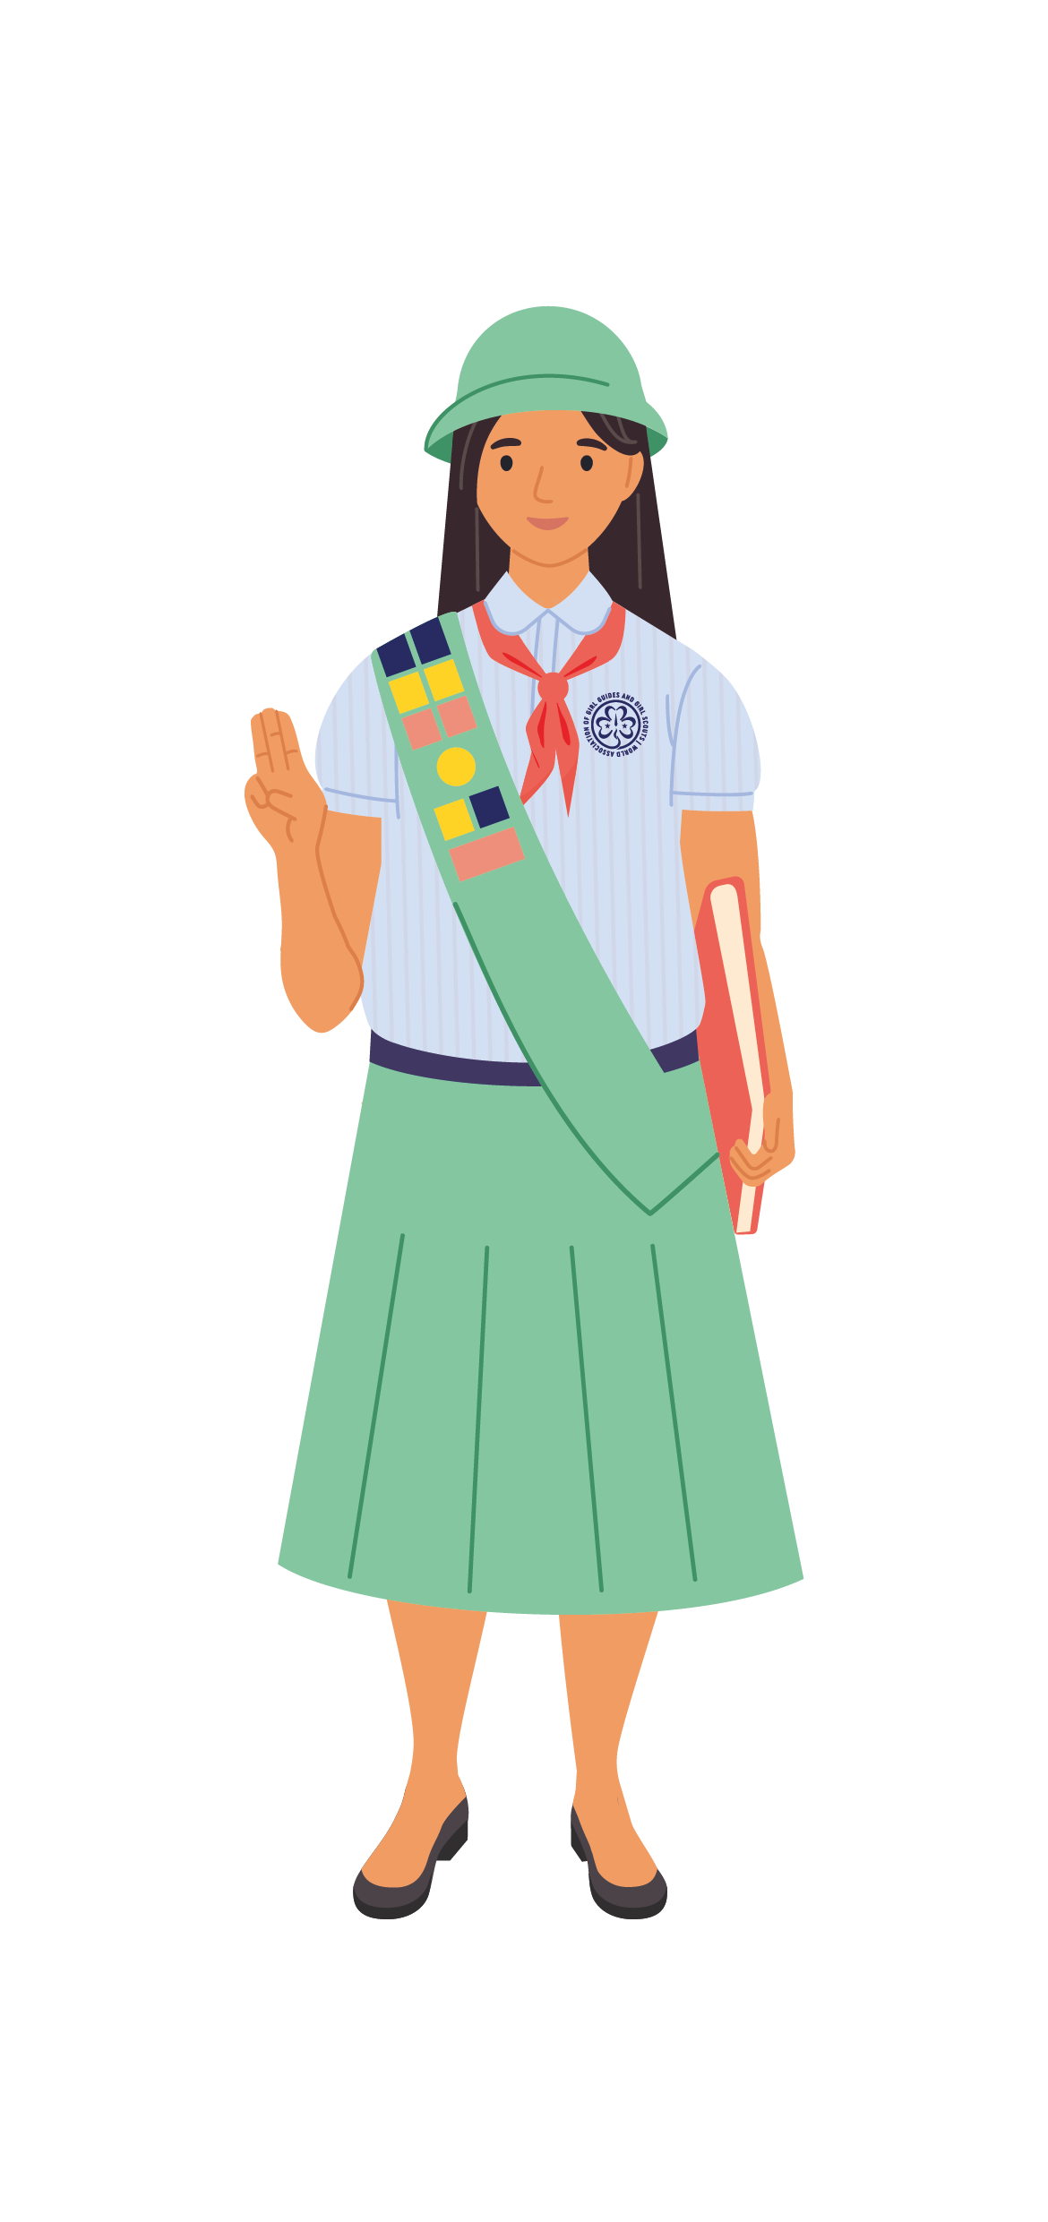
Prejudice means ‘to judge before’.
It is when we form a negative opinion or feeling about a person or group of people without understanding the bigger picture.
A Stereotype is a category, or a group, that we put people into.
It is when we think that people will act, talk or think in a certain way because of how they were born and where they are from.
Notes:
Activity steps:
Read aloud

Slide 21
This activity was adapted from the PeaceJam Foundation Compassion in Action curriculum
Read the definition of peace and peacebuilding on the next slide.
Arrange people into groups of two or three, ideally people that they do not usually talk to).
(these groups will be used later on in the activity)
A pencil or pen
Some paper
Notes:
(Optional)
This page is intended for leader’s information only

Slide 22
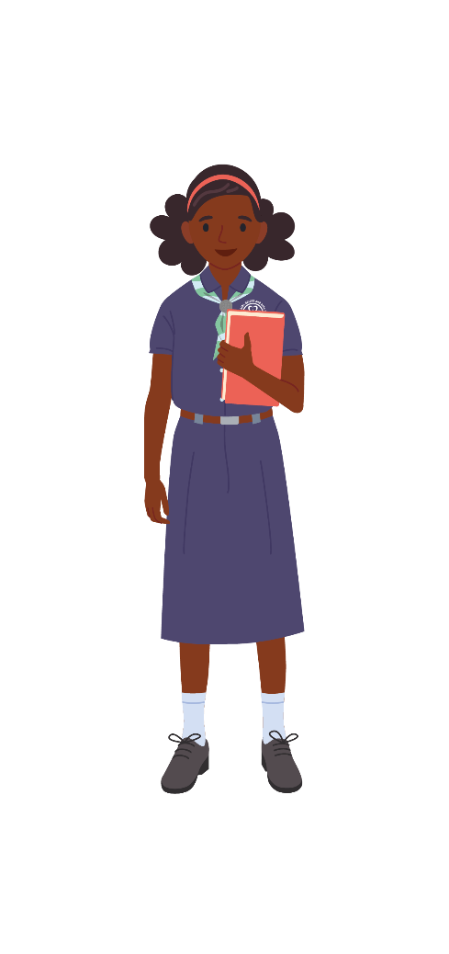
Peace is...
… not just the absence of war, it means dignity, safety, and well-being for all.
How peace is defined is different for everyone and it can range from being happy in ourselves and seeing the smiling faces of our loved ones, to conflict resolution within a community and ending violence and harmful practices around the world.
Peacebuilding is...
… about dealing with the reasons why people fight and supporting people to manage their differences and conflicts in a non-violent way.
It is very important to develop positive, personal and group relationships across different races, beliefs, cultures and classes. Understanding why people are different and why this is valuable and important helps us all to live in harmony.
Notes:
Read Aloud: Read out the definition of peace and peacebuilding for you group.
TIP: You may want to adapt the language to suit the abilities of your group. You can also choose to remove the definitions, keep the headings and only read the text aloud.

Slide 23
We are going to look our unique potential and how we can use this create an inclusive community inside and outside of Girl Guiding and Girl Scouting.
We all have unique skills and perspective (ways of seeing the world).
In other words, we each have unique potential.
Notes:
Activity steps:
Read aloud

Slide 24
ACTIVITY
Think about three positive things that people would say you contribute. How would each of the following groups answer this question about you:
(you should end up with three sets of answers)
We can always count on (your name) for _______, ________ and ________.
Your first friends when you were about five years old
Your Girl Guide or Girl Scout leaders
Your friends and classmates from school or teammates in a sports club.

Slide 25
ACTIVITY
Think about three positive things that people would say you contribute. How would each of the following groups answer this question about you:
(you should end up with three sets of answers)
We can always count on (your name) for _______, ________ and ________.
Your first friends when you were about five years old
Your Girl Guide or Girl Scout leaders
Your friends and classmates from school or teammates in a sports club.
Your first friends when you were about five years old…..
1.
2.
3.
Your friends and classmates from school or teammates in a sports club…..
1.
2.
3.
Your Girl Guide or Girl Scout leaders …
1.
2.
3.

Slide 26
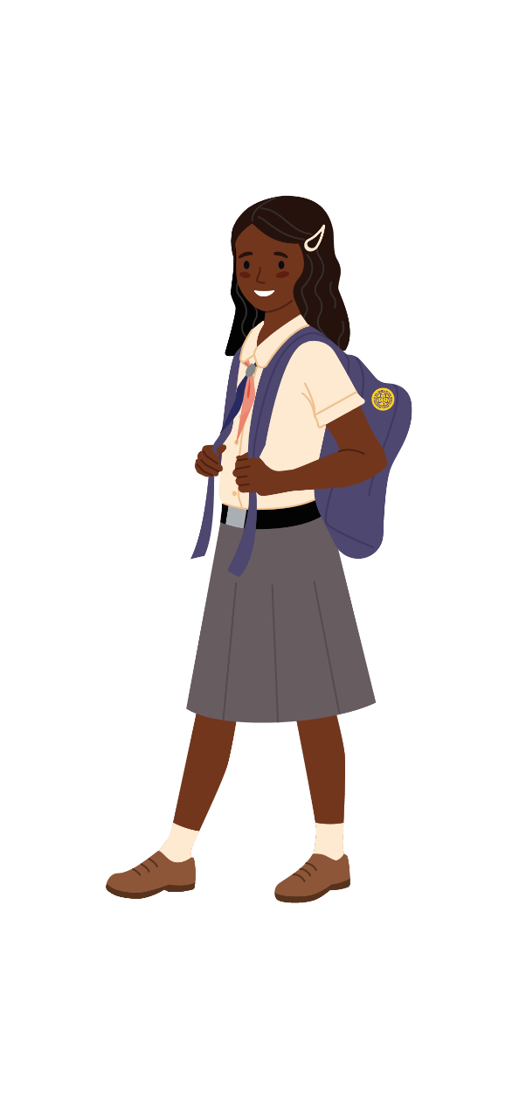
ACTIVITY
Now think about the unique potential of one person in your group*:
Choose one word that describes their contribution.
For example:
Ade is great at tying knots and always help others to do this.
Notes:
*Use the groups assigned at the start of the activity. This slide should take 60 – 90 seconds

Slide 27
ACTIVITY
Mime the word you chose to describe another person in your group. Act out the word without using any sound.
Everyone else now need to guess what it is.

Slide 28
LET’S REFLECT
Choose two questions to discuss.
Were the contributions you came up with for yourself easy to think of? Why do think that is?
How are your three contributions reflective of your unique potential, what do they say about you?
Which of these contributions are most valued by your group? Community? Society in general? Why do you think that is?
Why is it important to value the different ways people contribute to the world?
How can you use your unique potential to build peace in your local area?

Slide 30
This works best in small groups.
Pens and paper optional
Notes:
(Optional)
This page is intended for leader’s information only

Slide 31
ACTIVITY
Choose 3 storytellers:
The first storyteller:
has 90 seconds to tell a story about themselves involving conflict with other people.
It can be a simple story, or you can use the suggestions below.
Everyone else, then has 10 seconds to decide who caused the conflict.
Need some ideas? Pick a subject, object, and scene at random to create your conflict story.
Subject
Object
Scene
Old man
Young person and their dog
Teammates
Ball
Food shopping
Playing a game
Walking in the park
Fell over
Bumped into you

Slide 32
ACTIVITY
The second storyteller:
has 90 seconds to tell the same story, but from the point of view of another person in the story. Do not be afraid to make up details!
Everyone has 10 seconds to decide who caused the conflict. Did you change your mind?
The third storyteller:
he third storyteller:
tells the story from the point of view of another character.
10 seconds to decide! Did you change your mind again?

Slide 33
LET’S REFLECT
Did telling the story from different points of view help you think about the situation differently?
If everyone in the story thought about the others’ point of view, how do you think the situation may have changed?

Slide 34
Scan this QR code to view the Women Peacebuilder cards.
Download a copy of the Women Peacebuilder cards or view them using the QR code.
You can also make your own cards to add to the pack, to share the stories of inspiring women in your own country.
A copy of Women Peacebuilder cards, one card per person/pair or group
https://www.wagggs.org/en/resources/world-thinking-day-2021-activity-pack/
Notes:
(Optional)
This page is intended for leader’s information only

Slide 35
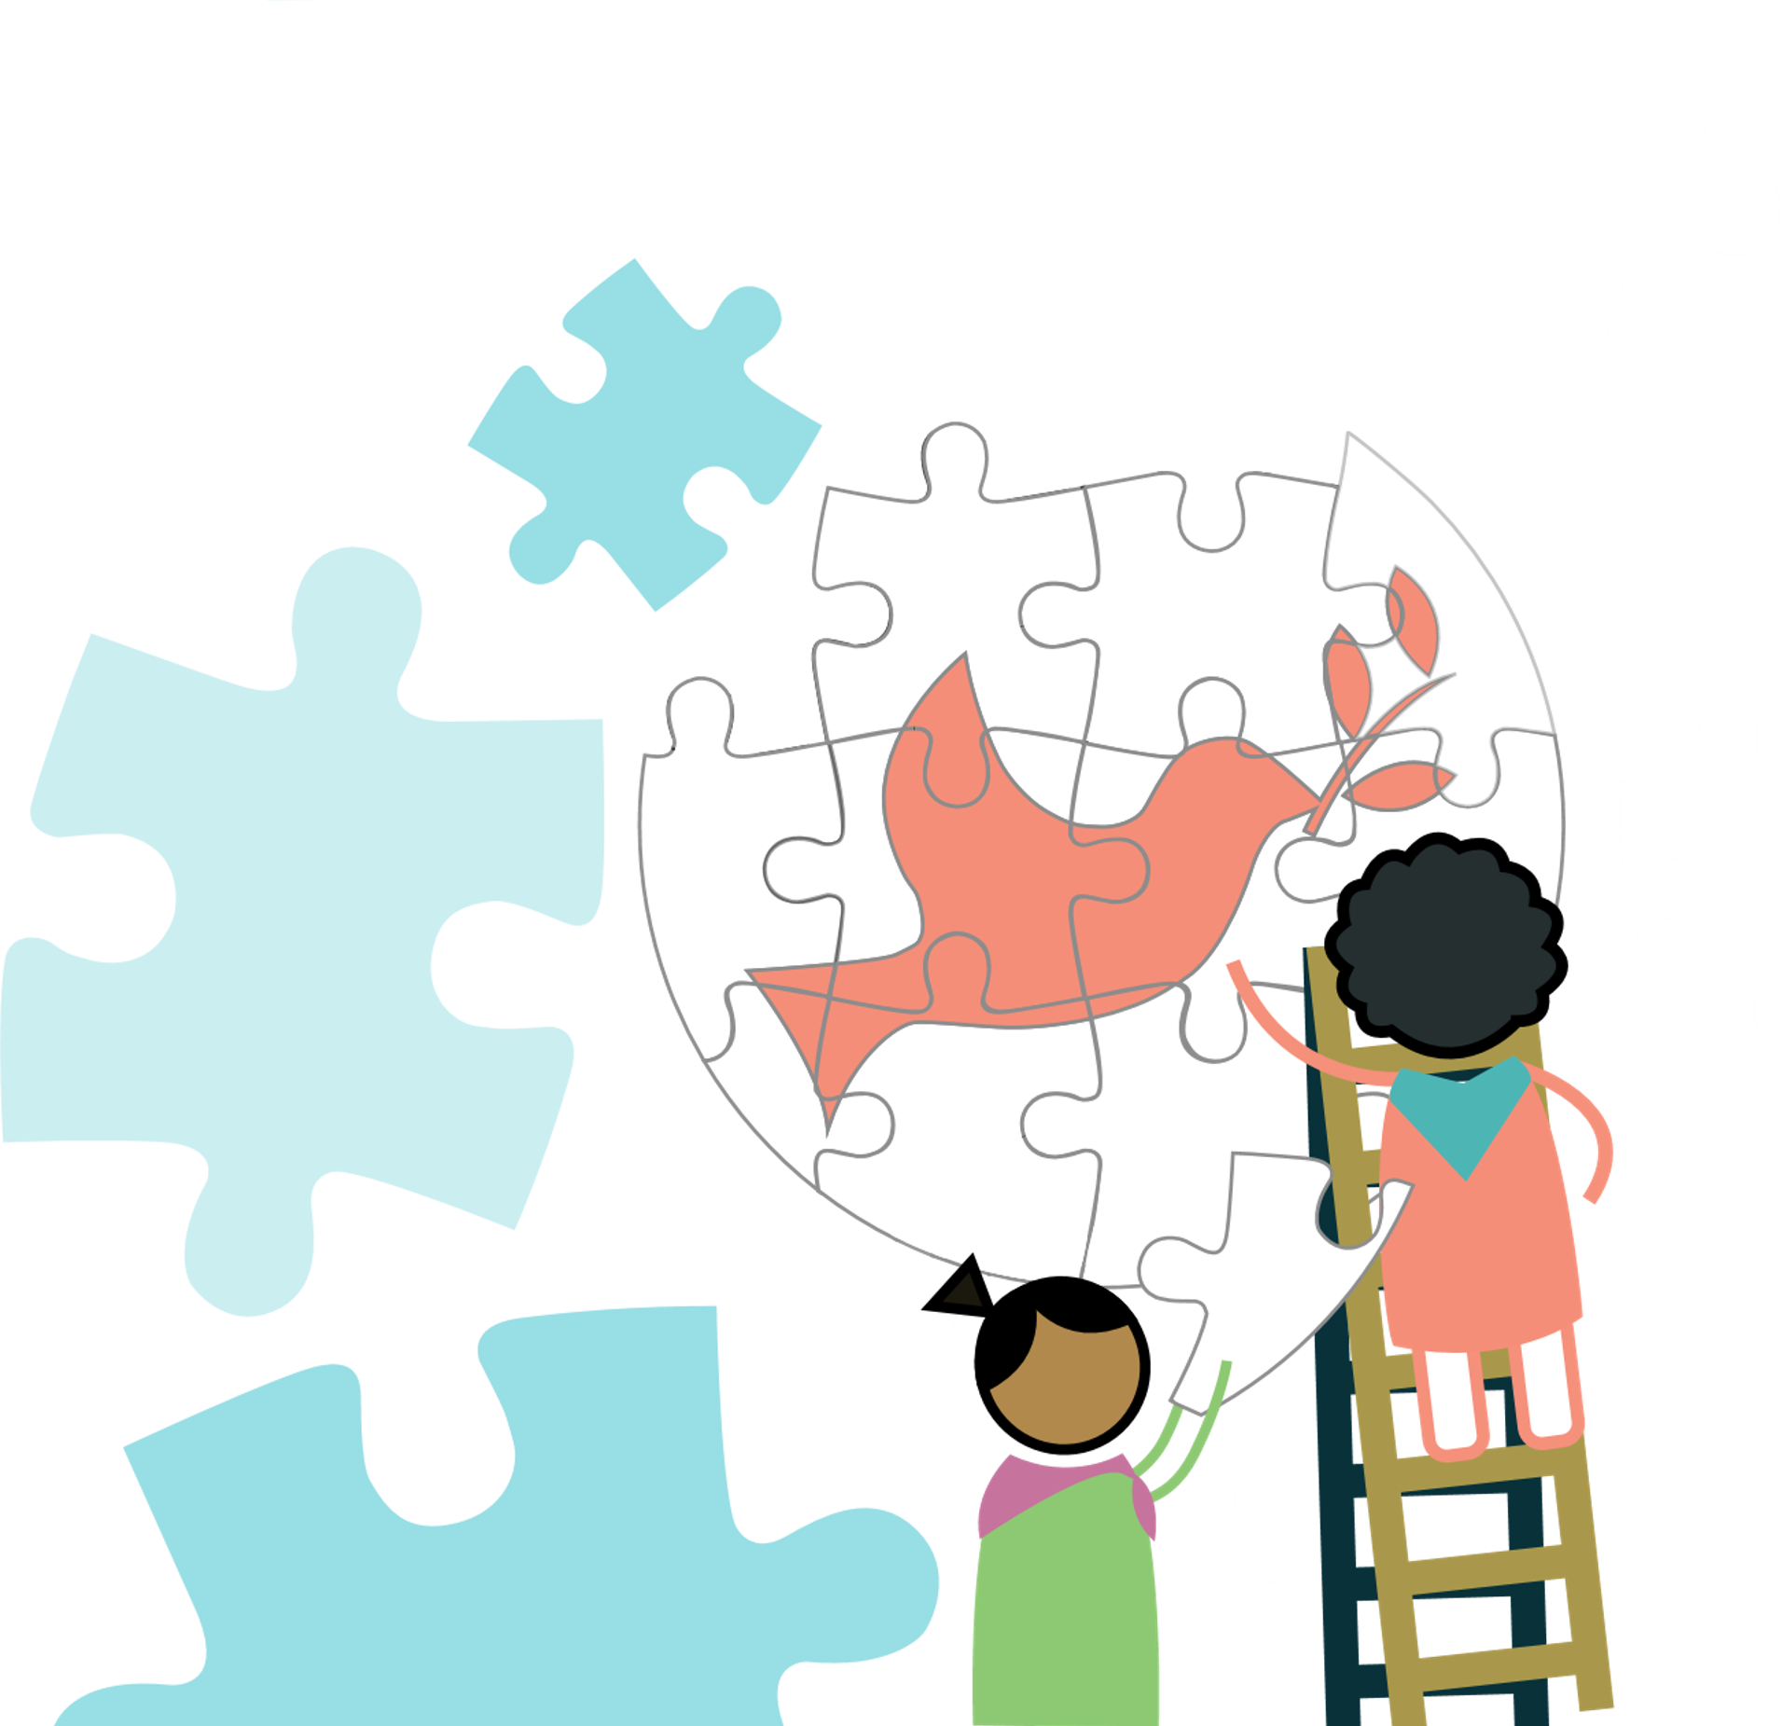
ACTIVITY
Choose a number from 1 – 11 and then scan the QR code*.
Congratulations! This person is now a Noble Peace Prize nominee.
(If this woman has already won a Noble Peace Prize, for this activity pretend she has not).
Scan this QR code to view the Women Peacebuilder cards.
https://www.wagggs.org/en/resources/world-thinking-day-2021-activity-pack/
Notes:
Tips for leaders:
*Alternative for working in groups
If you do not have the facilitates to scan a QR code, then divide into 11 pairs/groups and assign each pair/group the peacebuilder that corresponds with their group number. To access the Women Peacebuilder cards, please follow this link: https://www.wagggs.org/en/resources/world-thinking-day-2021-activity-pack/

Slide 36
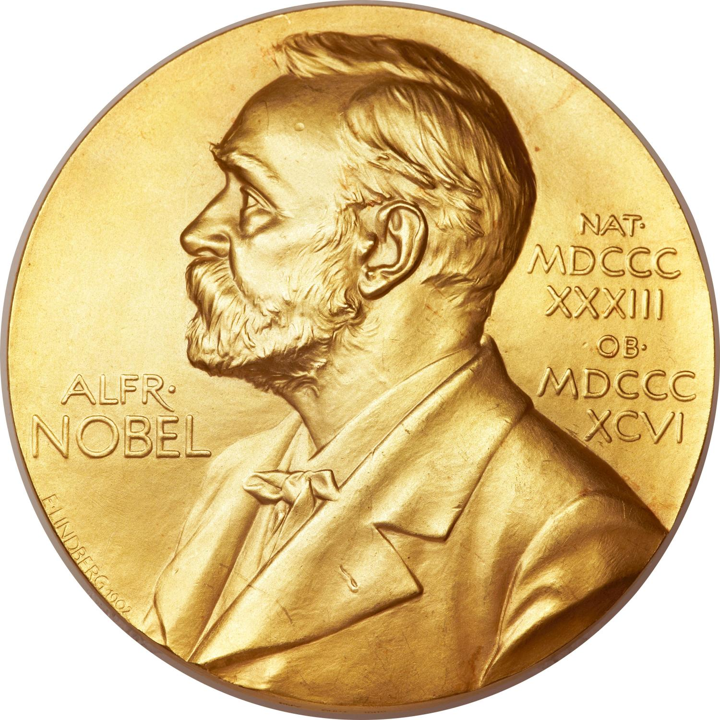
ACTIVITY
Imagine you are a member of the Noble Peace Prize committee. The committee tries to all agree on the selection of the Peace Prize Laureate. When there is not a unanimous decision, the selection is decided by a majority vote.
You must convince your fellow committee members (everyone you are completing this activity with) that the person you selected deserves this prize.

Slide 37
ACTIVITY
Spend time preparing your pitch
(if you are preparing your pitch as a group, select one person to present).
Each person in your group will have 45 seconds to convince the committee members to vote for the person you are pitching.
Look at you’re the profile you have been given and think about:
The steps they made to build a more peaceful world
The barriers and obstacles they overcame
The difference they made in world
How they inspire you
Notes:
Tips for leaders:
Pitching ideas:
Depending on the time that you have available, you can ask the group to vote two or three pitches at a time (this may help everyone better remember the pitches).
The winners from each round can then pitch again (for 60 seconds) in the final
To access the Women Peacebuilders cards, please follow this link: https://www.wagggs.org/en/resources/world-thinking-day-2021-activity-pack/

Slide 38
ACTIVITY
It’s time to pitch!
You each have 45 seconds to pitch your nominee.
Remember
You will be voting later, so you may want to take notes.
You can also add additional rule, for example, no group can vote for the nominee that they are pitching.
Notes:
Tips for leaders:
Pitching ideas:
Depending on the time that you have available, you can ask the group to vote two or three pitches at a time (this may help everyone better remember the pitches).
The winners from each round can then pitch again (for 60 seconds) in the final
To access the Women Peacebuilders cards, please follow this link: https://www.wagggs.org/en/resources/world-thinking-day-2021-activity-pack/

Slide 39
Now that you have heard everyone’s pitch, vote for the peacebuilder you feel, should be the next Peace Prize Laureate.
Did you know?
The Noble Peace Prize is an award given to someone who has done great work in; building peace between countries, reducing standing armies, or creating peace organisations.
Of the 107 individuals awarded the Nobel Peace Prize, 17 are women.
Complete an activity from the ‘Stand Together’ section and take action and build peace in your community.

Slide 41
This activity idea was provided by 2nd Brownie Troop of Larissa from Greek Girl Guides Association
Prepare art materials, including protection for messy materials.
Arrange people into smaller groups (if possible).
This will allow you to work as teams throughout this activity
Creative materials depending on what kind of artwork you decide to do.
Notes:
(Optional)
This page is intended for leader’s information only

Slide 42
ACTIVITY
Let’s revisit what Peace and Peacebuilding mean!
Peace is...
… not just the absence of war, it means dignity, safety, and well-being for all.
How peace is defined is different for everyone and it can range from being happy in ourselves and seeing the smiling faces of our loved ones, to conflict resolution within a community and ending violence and harmful practices around the world.
Peacebuilding is...
… about dealing with the reasons why people fight and supporting people to manage their differences and conflicts in a non-violent way.
It is very important to develop positive, personal and group relationships across different races, beliefs, cultures and classes. Understanding why people are different and why this is valuable and important helps us all to live in harmony.

Slide 43
ACTIVITY
Let’s revisit what Peace and Peacebuilding mean!
Ask yourself or each other: what does peace mean to you? Write down key thoughts, images, or ideas.
If you are working in small teams, divide into your groups now.
As a team share your ideas and decide how you can present these ideas to the rest of your group in a creative way?
Ideas:
create a painting, collage, drawing, or another form of artwork
use natural materials
perform a drama skit
write a song or poem

Slide 44
ACTIVITY
Get creative…
How can your art inspire others to think about what peace and peacebuilding means to them?
Write a short description or blurb to tell others what your creative work is all about and what peace means to you.

Slide 45
LET’S REFLECT
How can art be used to promote peace?
how can your group use art to inspire others to build peace?
Share what you have created!
Hold a peace exhibition to invite others to be part of a conversation about peacebuilding.
You could even use this as an opportunity to fundraise for the World Thinking Day Fund!
Share your photos, art, and ideas with Girl Guides and Girl Scouts around the world by using the hashtags:
#WTD2020 #WorldThinkingDay #StandTogetherForPeace

Slide 46
Each player needs a coin (the year on the coin should be a year in their life).
Arrange people into smaller groups (if possible).
Coins
Drawing materials
Writing material
An audio recorder
Notes:
(Optional)
This page is intended for leader’s information only

Slide 47
Tip
Subtract the year that you were born from the date on the coin.
The answer is how old you were when the coin was minted.
ACTIVITY
Look at the year printed on your coin and calculate how old you were when this coin was minted. Make note of this age.
Think about the following questions and select a few people to share their answers:
What is your most vivid memory from that year?
What might have been doing when you were that age?
What was your favourite thing to do at that age?
What was your favourite food?
Tip
You can also share your thoughts with your group by writing, drawing or recording an audio clip.

Slide 48
ACTIVITY
Now share one thing that would have made your life more peaceful at that time?
As a Girl Guide or a Girl Scout, you have the power to build peace, by doing a good turn every day.
Come up with one good turn or act of peace could you do now, that would have helped the younger you?
Collect and send
You could collect the coins used in the activity and add to your group’s World Thinking Day Fund contribution.

Slide 49
This activity was contributed by Troop 500, Troop Sikatuna, Girl Scouts of the Philippines.
Scan this QR code to see the full activity pack.
Make sure that your groups members have parent or guardian permission to be recorded and have their videos shared.
A copy of the World Badge, approx. 20cm x 20 cm, the other side must be blank.
Print it or draw it yourself!
You can find the template on page 62 of the online activity pack
https://www.wagggs.org/en/resources/world-thinking-day-2021-activity-pack/
Notes:
(Optional)
This page is intended for leader’s information only

Slide 50
ACTIVITY
Divide into small groups.
Think about everything you have discovered about peacebuilding. In your groups, answer the following questions.
How can you welcome people in your community and even include them in some of your activities?
What can you do to better understand people who are different to you?
How can you resolve conflicts in your community before they become issues?

Slide 51
ACTIVITY
Create a video.
Send your video to WAGGGS at WTD@wagggs.org or
share this on social media using the hashtags:
#WTD2020 #WorldThinkingDay #StandTogetherForPeace
Put together a message about how Girl Guides and Girl Scouts can shape peace on the blank side of your trefoil. It can be a drawing, text, a collage, or a photo.
Record a video (maximum of 20 seconds) of you showing your drawing or reading your message for peacebuilding in your Girl Guide or Girl Scout uniform.
Then turn the message around to show the world trefoil and then pass the trefoil off screen, you can do it to any direction.
Tip
Colour in or decorate your trefoil. So it can really stand out.

Slide 52
Let’s be prepared
For this activity you will need
Read beforehand the definition of peace and peacebuilding on page 8
The ‘things I can change’ template. (a copy of this is on the next slide).
In case of big groups, we recommend you use breakout rooms for the discussion.
Notes:
(Optional)
This page is intended for leader’s information only

Slide 53
ACTIVITY
Look out the window or door and think about your community and people around you.
What issues stop your community being as equal and peaceful as it could be?
Now take 5 minutes to fill up the template then start the discussion around the following questions:
What one issue did you feel most strongly about?
What do you think causes this issue?
What would your ideal and peaceful solution look like?
What obstacles make it hard to reach that solution?
Notes:
Leaders instructions:
1. In breakout rooms or with the whole group, think and share:
What actions could they take to remove the obstacle or resolve the issue?
2. Once the discussion is finished, for the whole group ask some of them to share their templates, issues, and solutions on the screen.
Read Out: There are many things that impact our lives, and some are easier to change than others. Arrange the actions on a scale of easy, medium, hard.

Slide 54
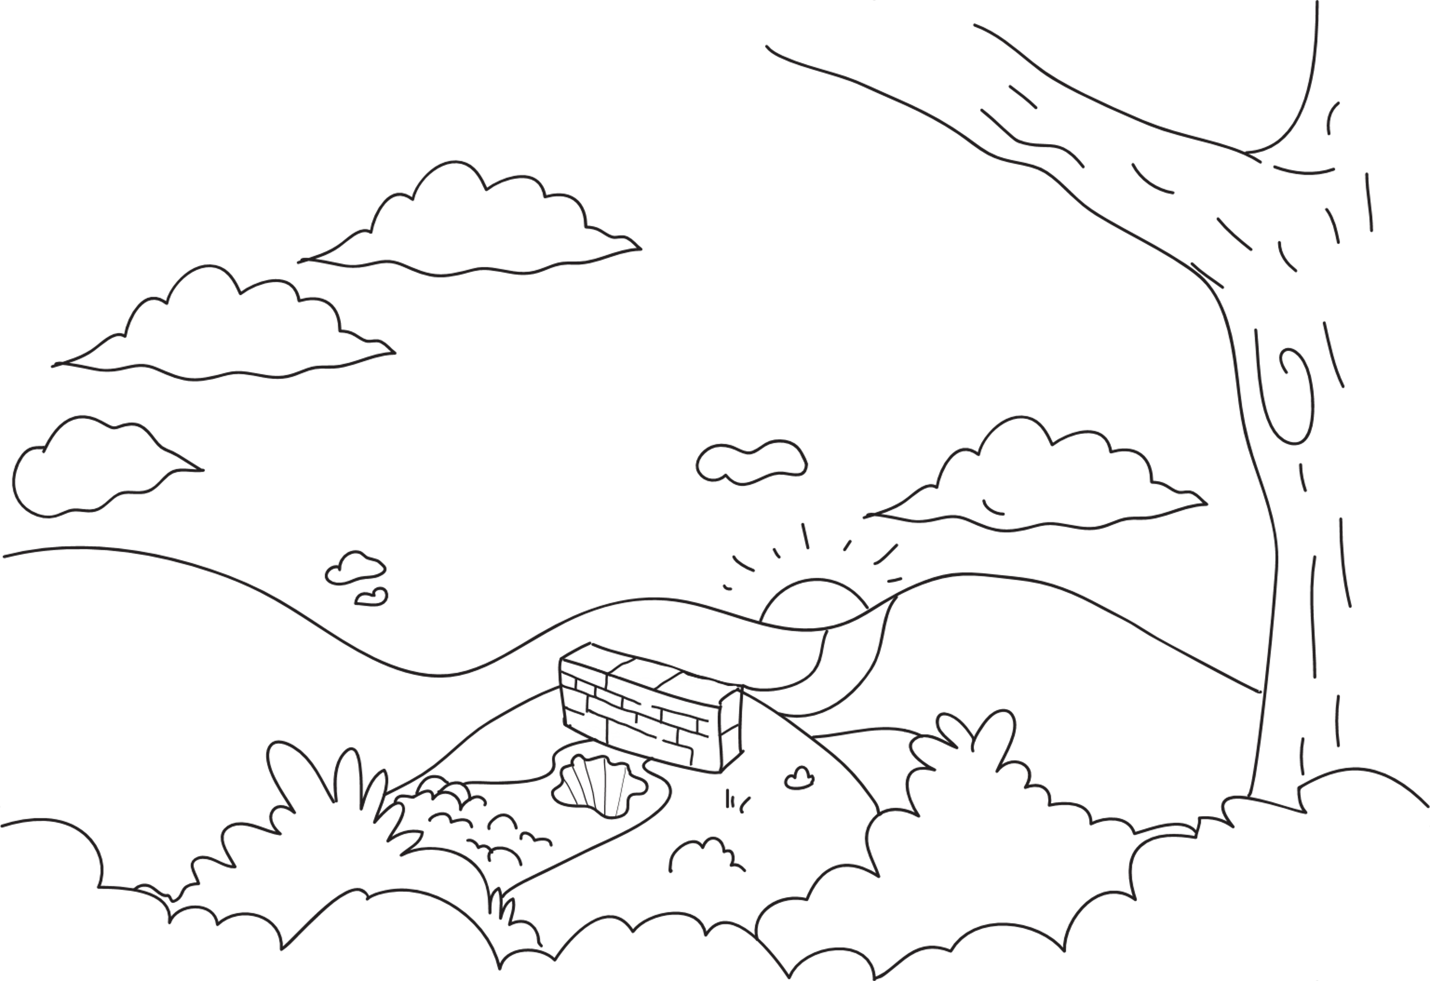
PEACEFUL SITUATION
What ideal scenario can you imagine?
OBSTACLE
How is this issue stopping the ideal scenario from happening?
CAUSE
How is this issue stopping the ideal scenario from happening?
ISSUE
What issue can you see?
Notes:
Leaders instructions:
1. In breakout rooms or with the whole group, think and share:
What actions could they take to remove the obstacle or resolve the issue?
2. Once the discussion is finished, for the whole group ask some of them to share their templates, issues, and solutions on the screen.
Read Out: There are many things that impact our lives, and some are easier to change than others. Arrange the actions on a scale of easy, medium, hard.

Slide 55
Easy
Medium
Hard
You have power to build peace and create change!
Notes:
Leaders instructions:
1. In breakout rooms or with the whole group, think and share:
What actions could they take to remove the obstacle or resolve the issue?
2. Once the discussion is finished, for the whole group ask some of them to share their templates, issues, and solutions on the screen.
Read Out: There are many things that impact our lives, and some are easier to change than others. Give each group a few minutes to arrange the actions on a scale of easy, medium, hard.
AFTER ALL GROUPS HAVE COMPLETED THEIR ACTIONS BRING THEM BACK TOGETHER.
Read aloud: You have power to build peace and create change! Keep your Change Picture. Are you ready to act on the issue you identified? Is there anything you think is impossible to change? Why?
Leaders: Keep track on the actions and further steps the girls can take about the mentioned issues

Slide 56
Let’s be prepared
Let’s stay safe
Half fill a bowl with water.
You will also need some small pebbles. (if you cannot access any small pebbles, this can be replaced by a small grain/seed)
This activity includes water, make sure the necessary precautions are in place.
Notes:
(Optional)
This page is intended for leader’s information only

Slide 57
ACTIVITY
What would happen if ten million Girl Guides and Girl Scouts all took one action toward peace?
Close your eyes and listen to the narrator.
Now pick up the pebble and close your eyes. How does it feel in your hand? Where do you think it has been? Think of the journey it has been on, and the amazing, joyful, and peaceful moments it has seen.
Now take a few pebbles and drop these into the bowl together - what did the water do this time? How did the ripple change? Was there more movement?
Decide on an action you would like to take within the next week to build this feeling of peace.
Notes:
Leaders instructions:
Narrator read aloud:
1. What would happen if ten million Girl Guides and Girl Scouts all took one action toward peace, what would those ripples look like? What difference would that make in the world?
2. Now pick up the pebble and close your eyes. How does it feel in your hand? Where do you think it has been? Think of the journey it has been on, and the amazing, joyful, and peaceful moments it has seen. One small stone can make an impact - but imagine the impact of lots of stones together.
3. Now take a few pebbles and drop these into the bowl together - what did the water do this time? How did the ripple change? Was there more movement? Imagine that each pebble is an act of peace. It makes a ripple and can have a larger impact than you might imagine.
4. Think of the impact that you can make as one of ten million Girl Guides and Girl Scouts all working towards building peace.

Slide 58
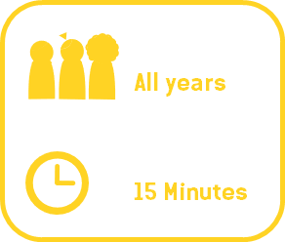
ACTIVITY
Renew your Promise and your commitment to building peace and shaping a positive future.
Be the best version of ourselves
End your World Thinking Day activities by holding a Promise ceremony
Keep the Girl Guide or Girl Scout Law
Assist our community
and country
Notes:
Leaders instructions:
Read aloud: As Girl Guides and Girl Scouts we share a set of unique values that help us to live with purpose to make the world a better place. The Promise, although it differs for every country, has three main parts:

Slide 59
ACTIVITY
Renew your Promise and your commitment to building peace and shaping a positive future.
Write down on act of peace (a good turn) that you can do to help build peace.
Now look at ‘promises from around the world’ read at least one Girl Guide/Girl Scout promises from another country.
How is the promise different or the same as yours?
Notes:
Leaders instructions:
Read aloud: If we all took steps together towards a more peaceful world and did a good turn every day that would be ten million
acts of peace each day and three billion, six hundred and fifty million acts of peace each year!

Slide 60
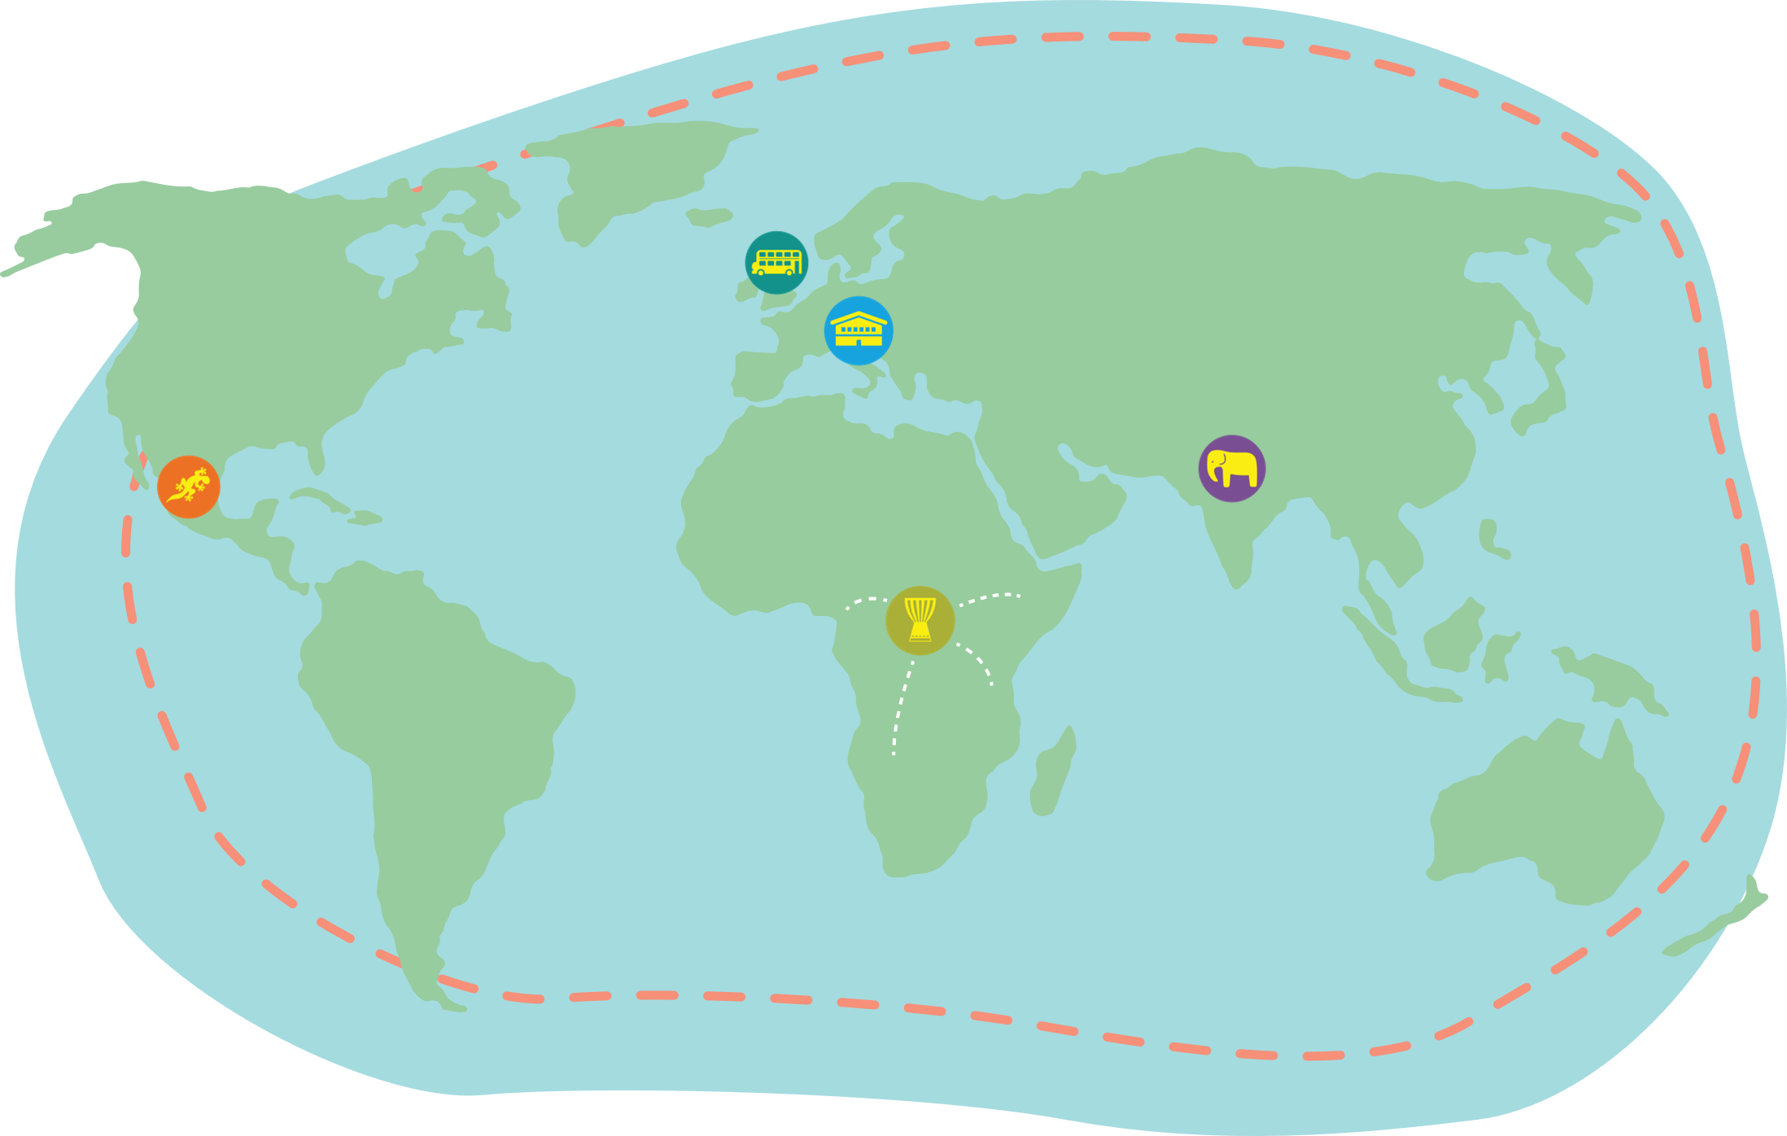
‘With the help of God, with your help and happily’
or ‘With your help and happily’
I promise to do my best:
To study in detail the values of our Girl Scout Law,
To search for the meaning of my life,
To be involved in the community where I live
– Switzerland Girl Scout Promise
On my honour,
I promise that I will do my best
to do my duty to God and my country,
To help others and To obey the Girl scout/Girl Guides
- Syria Girl Guide Promise
I promise that I will do my best
To be true to myself and develop my beliefs
To serve my community and Australia
And live by the Guide Law
– Australia Girl Guide Promise
I promise on my honour to do my best:
To do my duty to God and my country,
To help other people at all times, and
To obey the Guide Law.
- Venezuela Guide Promise
I promise on my honour that
I will do my best:
To do my duty to God and my Country,
To help other people at all times and
To obey the Guide Law.
- Kenya Girl Guide Promise

Slide 61
ACTIVITY
Share the act of peace (good turn) that you have written, and then re-make your promise as a group
LET’S REFLECT
The World Association of Girl Guides and Girl Scouts represent over ten million Girl Guides and Girl Scouts.
What other countries can you think of that might have Girl Guides and Girl Scouts?
What do you think life for a girl like you in that country might be like?
Do you really know? How could you find out?
Notes:
Leaders instructions:

Slide 62
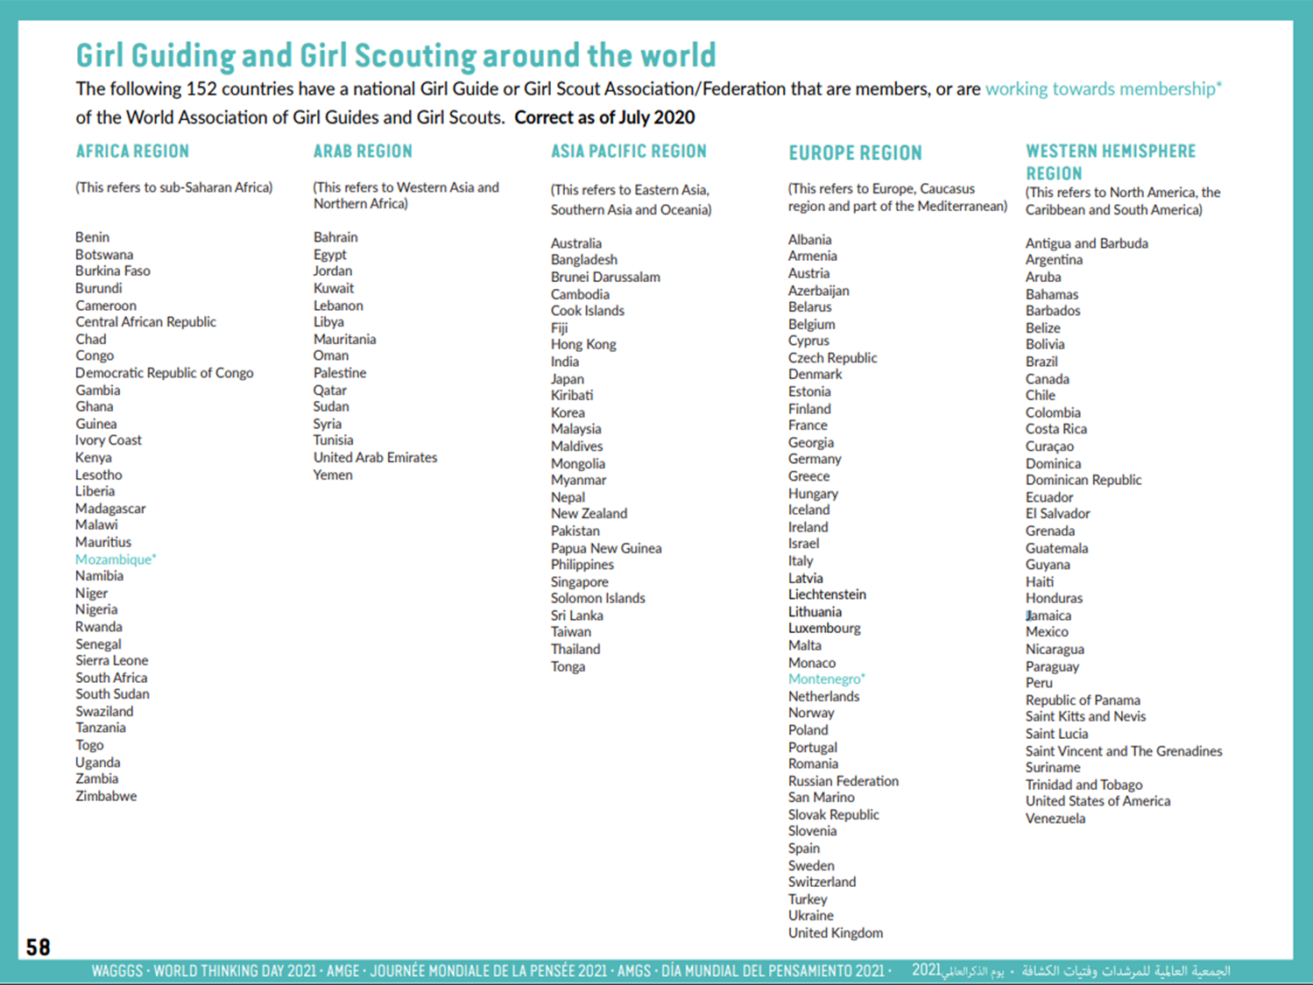
This is a copy of page 58 of the World Thinking Day activity pack
Notes:
Leaders instructions:
Use this page to confirm which countries have Girl Guides or Girl Scouts.

